Slide 1
COMPUTER VISION (19CSE435)
TOPIC: identifying the cracks in the wall using thermal imaging or infrared images
Name: | Roll.No:
Abisheak Raj | CB.EN.U4CSE21402
Mitesh V | CB.EN.U4CSE21438
Nithin G | CB.EN.U4CSE21443
Sharvesh S | CB.EN.U4CSE21454

Slide 2
PROBLEM STATEMENT : Identifying the cracks in the wall using thermal imaging.
Cracks or defects in a wall, they can cause temperature variations due to differences in material properties, moisture content, or airflow. Thermal imaging can detect these temperature differences, allowing for the identification of cracks that may not be apparent through traditional visual inspection methods.
Design and develop an algorithm that integrates thermal imaging technology into the inspection and maintenance processes of buildings or structures.
Design and develop an algorithm to enhance the accuracy and reliability of crack detection compared to conventional methods.

Slide 3
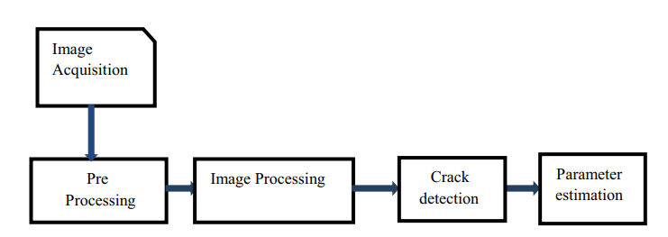
RESEARCH PAPER 1
LINK: https://www.sciencedirect.com/science/article/pii/S1110016817300236?pes=vor
Crack detection using image processing: A critical review and analysis:
This paper briefly explains about the process of detecting cracks on wall using various techniques like
IR-based image processing.
Ultrasonic image based processing.
Etc..
Architecture:

Slide 4
IR-based image processing.
This paper proposes an IR thermography method based on image rectification and isotherm extraction for crack detection. This method allows for fast assessment and geometric characterization of cracks, aiding in predicting crack propagation direction.
They propose crack detection based on notches in irregularities using IR thermography image rectification.
This paper provides accuracy level information for each processes. It also proposes and explains various limitations that we may face , when we use image processing for crack detection.

Slide 5
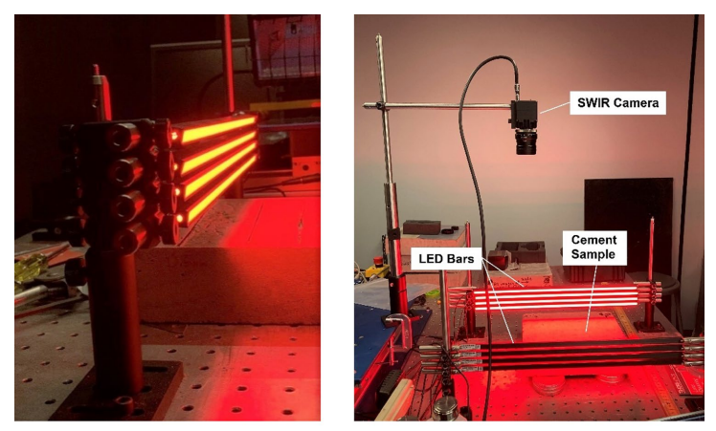
RESEARCH PAPER 2
LINK : https://www.nature.com/articles/s41598-023-45917-3
Detection of cracks in concrete using near-IR fluorescence imaging
This paper explores a novel approach for detecting cracks in concrete using infrared imaging, specifically focusing on the near-infrared (NIR) fluorescence emitted by concrete when excited by red LED light.
Traditional crack detection methods often involve visual inspection or specialized equipment like ultrasonic devices or ground-penetrating radar, but they have limitations in terms of accessibility and accuracy.
The researchers utilized the inherent fluorescence of concrete at around 1140 nm wavelength when excited by red light. By doing so , at a shallow angle of incidence, they were able to ensure that interior crack surfaces received no excitation, making cracks appear as dark features against the fluorescent concrete surface.

Slide 6
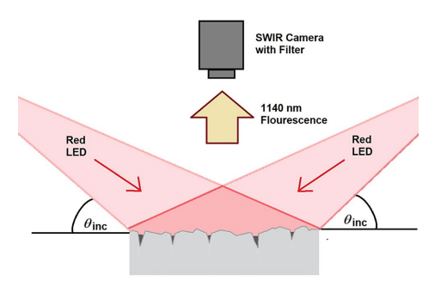
The researchers conducted experiments using a SWIR (short-wave infrared) camera to capture images of fluorescent concrete samples with artificial cracks of various widths. They also tested the method on a concrete sample with a real crack of 0.08 mm width.
RESULTS :
The NIR fluorescence imaging method could detect cracks as small as 0.08 mm width, demonstrating its potential for early crack detection before they pose significant structural risks.
The primary limitation observed was the relatively low resolution of the SWIR camera used, suggesting that higher resolution cameras could enable crack detection from larger distances

Slide 7
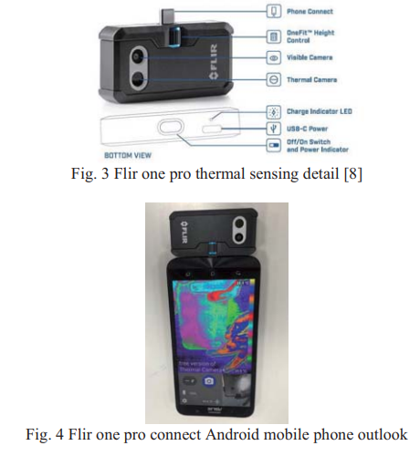
RESEARCH PAPER 3
LINK : https://ieeexplore.ieee.org/document/8942772
This research paper provides a detailed overview of various methods for detecting and analyzing structural issues such as cracks and leaks in buildings, particularly focusing on the application of thermal sensors for assessment.
This paper suggests Thermal Sensor Application as the solution to detect cracks and the Flir One Pro thermal sensor is highlighted as a specific tool for providing detailed analysis through its associated software.

Slide 8
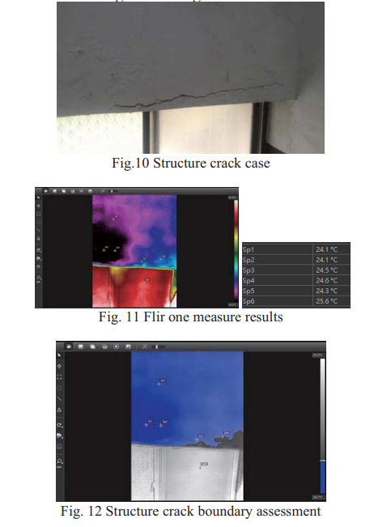
Thermal sensors offer a quick and effective way to identify areas affected by leakage and structural issues. They accurately capture the location , extent of structural cracks and can help define damage locations for maintenance purposes.
Overall, the paper suggests that thermal sensors present a promising solution for real-time assessment of building structures, offering advantages over traditional methods in terms of efficiency and accessibility.

Slide 9
Motivation for the project
EARLY DETECTION :
Cracks in walls can indicate the structural weakness of the buildings so detecting them early can save lot of possible accidents.
Identifying cracks in walls early can prevent structural issues from worsening, so costly repairs and hazards can be avoided.
EFFICIENCY:
Thermal imaging provides detailed data on temperature variations, which will help in precise identification of cracks and their severity.

Slide 10
LIMITATIONS OF THE PROJECT
How can we ensure that thermal imaging detects cracks accurately from other anomalies or natural variations in the wall ?
Can thermal imaging reliably determine the depth of cracks within the wall ?
Does the resolution of thermal images affect the ability to detect subtle cracks accurately?
How do we develop algorithms or models to interpret thermal imaging data effectively ?

Slide 11
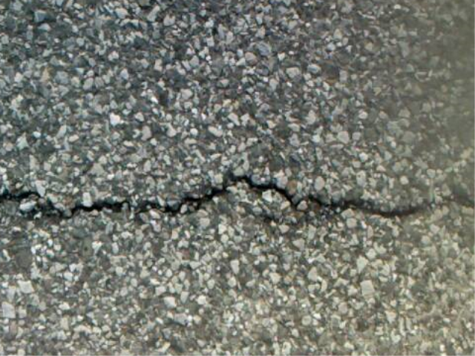
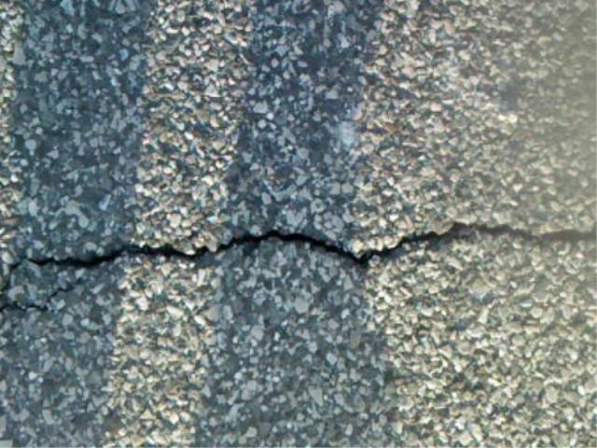
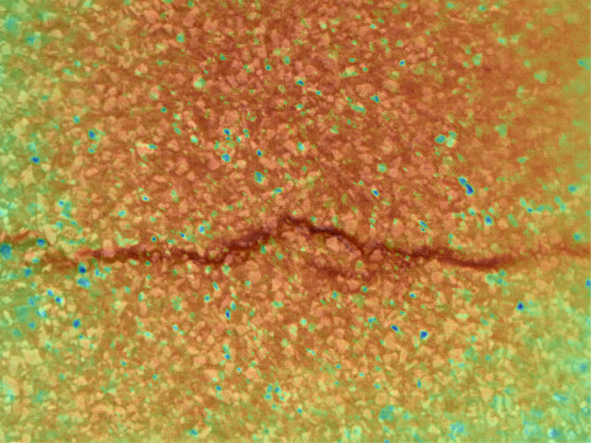
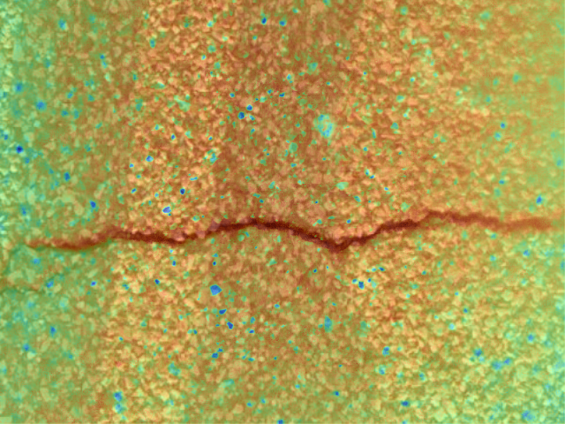
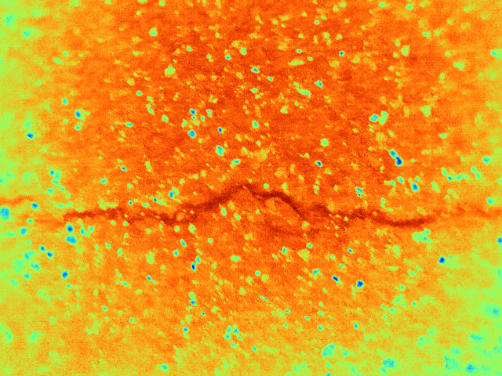
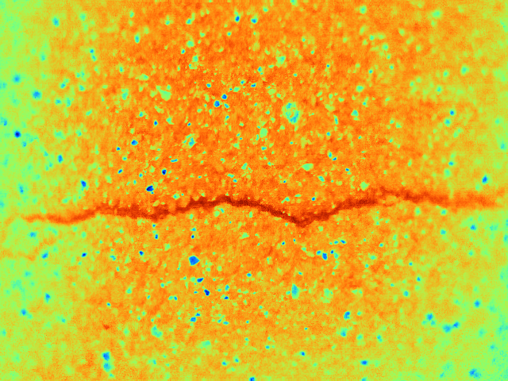

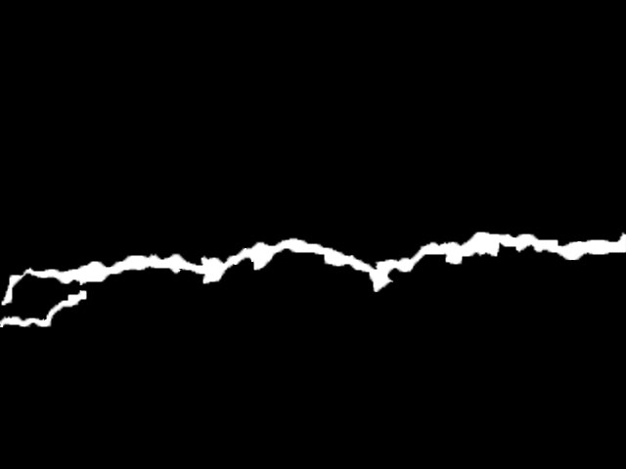
DATASET
FUSION image set :
Normal image set :
IR image set :
GROUND TRUTH :

Slide 12
FUTURE PLANS FOR THE TEAM
Gather feedback from stakeholders, including engineers, inspectors, and potential end-users. Incorporate feedback to further enhance the usability, functionality, and practicality of the crack detection system.
Optimize algorithms for real-time processing and detection speed. Fine-tune parameters to improve the accuracy and robustness of crack detection.
Continuously update the system with new features based on advancements in thermal imaging technology and crack detection methodologies.

